Slide 1

Information Assurance
Week 1 – Introduction To Information Assurance

Slide 2
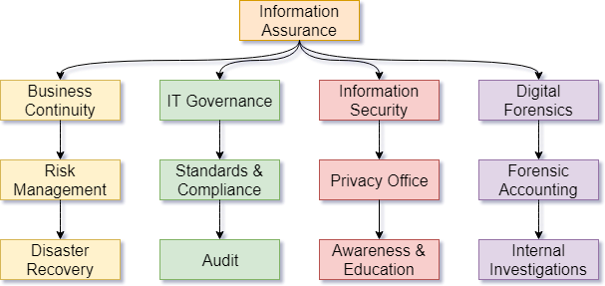

Slide 3
Information Assurance Mission
So, what assurances are being assured in Information Assurance?
To ensure, to the best degree possible with available resources, and in support of business operations, that the constituency served can:
Be assured they can trust the information they use.
Be assured that their information will only be shared in the manner they expect.
Be assured the information will be available when they need it.
Be assured the systems they use will process information in a timely and trustworthy manner.

Slide 4
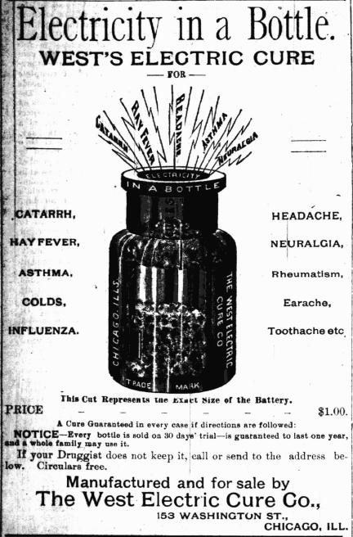
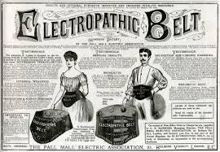
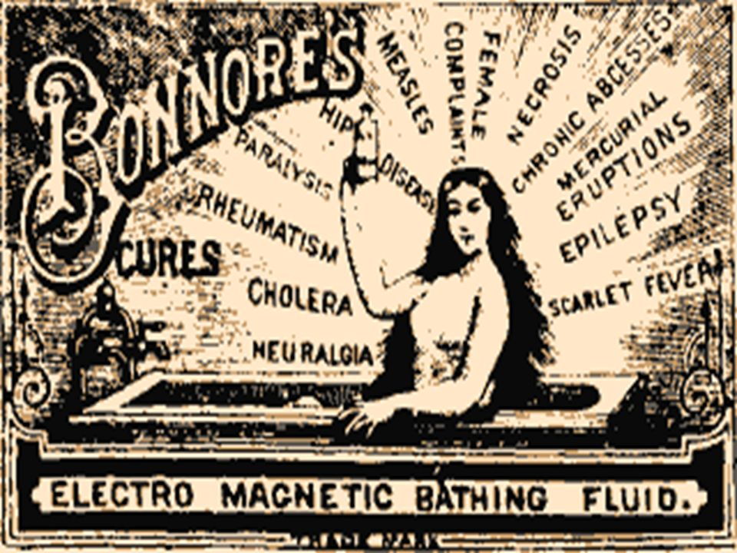
Miracle Electro-Computators!

Slide 5
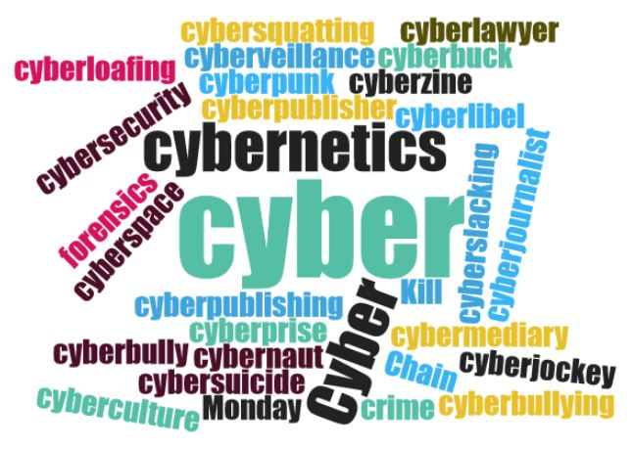
Miracle Cyber-Computators!

Slide 6
Get off my lawn!
“If men learn this, it will implant forgetfulness in their souls; they will cease to exercise memory because they rely on that which is written, calling things to remembrance no longer from within themselves, but by means of external marks. What you have discovered is a recipe not for memory, but for reminder. And it is no true wisdom that you offer your disciples, but only its semblance, for by telling them of many things without teaching them you will make them seem to know much, while for the most part they know nothing, and as men filled, not with wisdom, but with the conceit of wisdom, they will be a burden to their fellows.” - Plato

Slide 7

Get off my lawn!
“A Google search is not the same as knowing something.” – Some boomer, probably.
Knowledge vs. Information

Slide 8
Get off my lawn!
“The children now love luxury; they have bad manners, contempt for authority; they show disrespect for elders and love chatter in place of exercise. Children are now tyrants, not the servants of their households. They no longer rise when elders enter the room. They contradict their parents, chatter before company, gobble up dainties at the table, cross their legs, and tyrannize their teachers.” – Socrates (not really)

Slide 9

Generations blaming each other for being lazy, selfish, destructive, stupid, blah blah blah

Slide 10
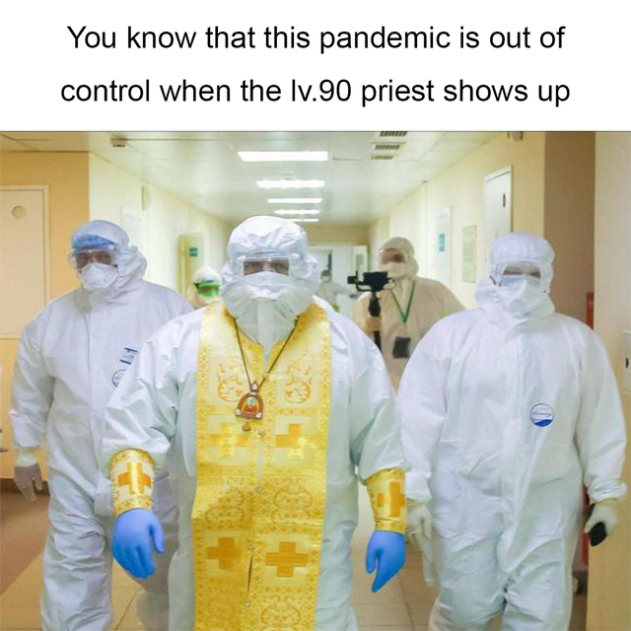


Slide 11


Slide 12


Slide 13
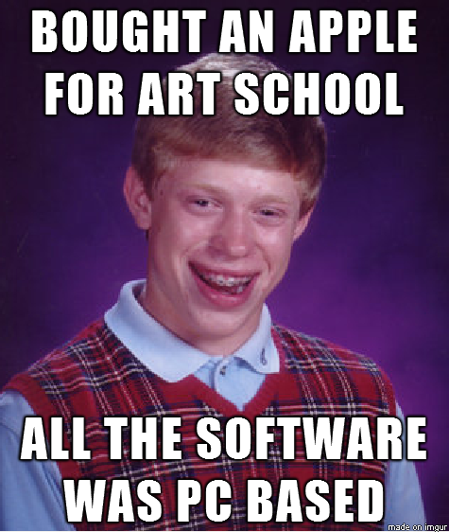

Slide 14
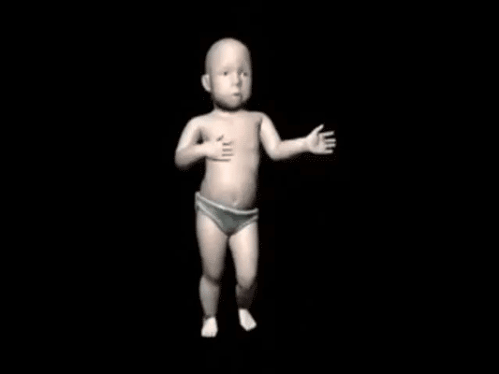

Slide 15



Slide 16
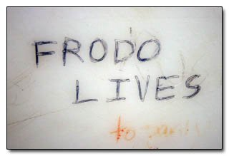

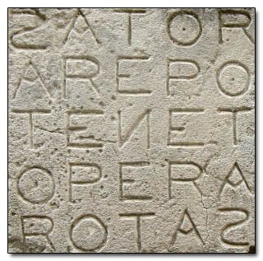
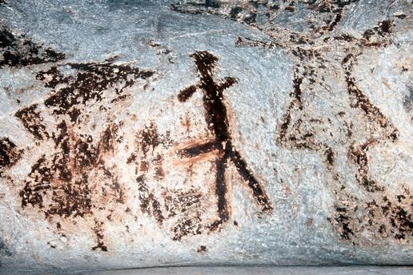
Okay?

Slide 17
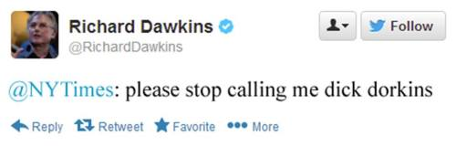
Contextualizing Online Society
The word meme was coined in 1976 by the evolutionary biologist Richard Dawkins. It is a word to describe the concept of “cultural transmission.” The proliferation of customs and ideas, not via broadcast, but person to person.
Zeitgeist – The defining spirit or mood of a period in history as shown by the ideas and beliefs of the time.
Roaring 20s.
Internet Manipulation

Slide 18
Thank God for them Internets.
It’s not worse. It’s different.
Why are computers a thing? What do they do for us?
Why is Big Data?
What about the Internet? What problems does it solve? What problems does it cause?

Slide 19
The Human Work
Communication
Lower transaction cost.
Date displacement.
Facilitation / Publishing authority
If the human work that Internet makes more efficient is communication, we can still expect people to congregate.
This leads to a process of self-selection.
Echo-chambers amplify.

Slide 20
Communicating Information
Consider one of the most important functions of communication – the transmission of knowledge and news.
Some say the 24-hour news cycle destroyed news,
Fake news
and the Internet destroyed opinion.
Clickbait
1900-1930s – Yellow journalism
1940s-1990s - Era of the Scoop
1990s-2000s – Fake news
2000s-2010s - Clickbait

Slide 21
Why it matters:
When a technology increases the efficiency of a system, it will also increase the instances of flaws in the system.
It does make it worse. It just make the bad faster along with the good. However, not all failures are equal. Consider: Butterfly Effect, Domino Effect, Snowball Effect, and Cascading Failures.

Slide 22
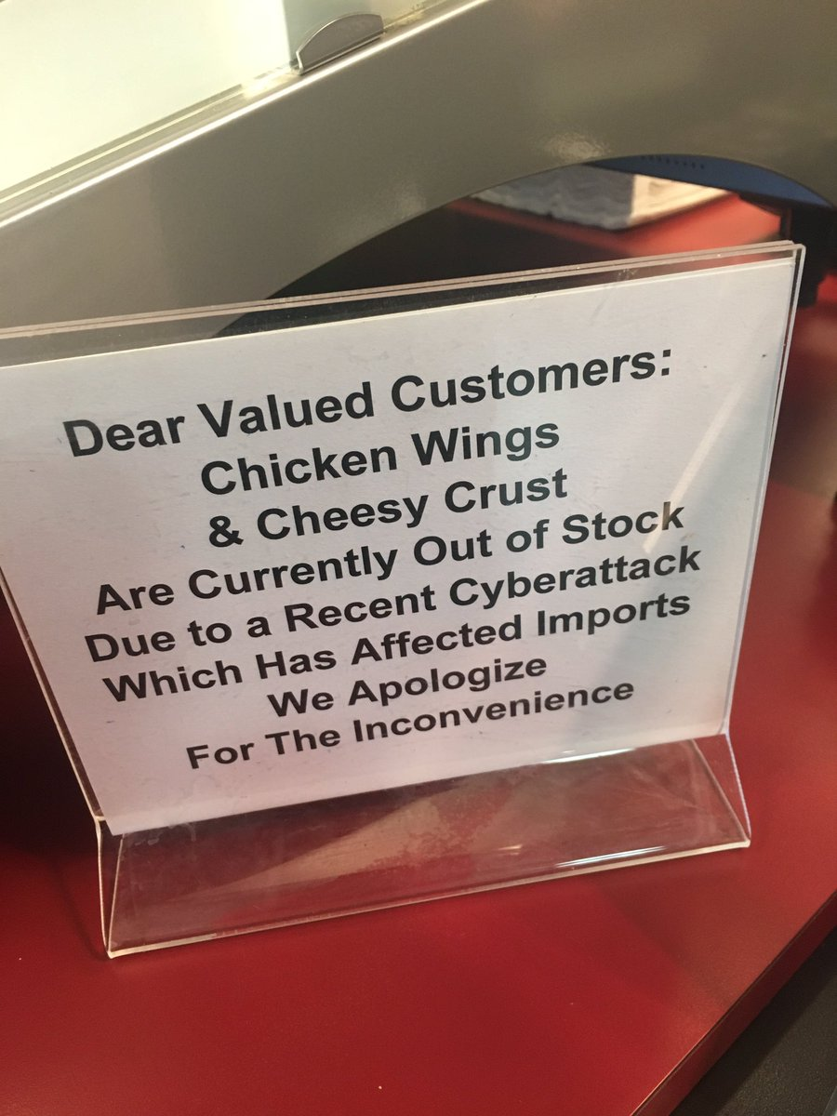
No computer is an island
What does it mean – technology “enhances” our lives?
Technology improves efficiency of human work.
Consider designing a car. Technology makes the process from design to purchase more efficient.
What does it mean – technology “supplements” our lives?
Technology replaces human work, taking humans out of the equation.
Consider that car… Robots assemble it. Computers provide crash-avoidance, auto-pilot, etc.
What does it mean – technology “supports” our lives?
Technology allows humans to do work that would otherwise not be possible.
Back to the car… Back-up cameras, GPS, etc.

Slide 23
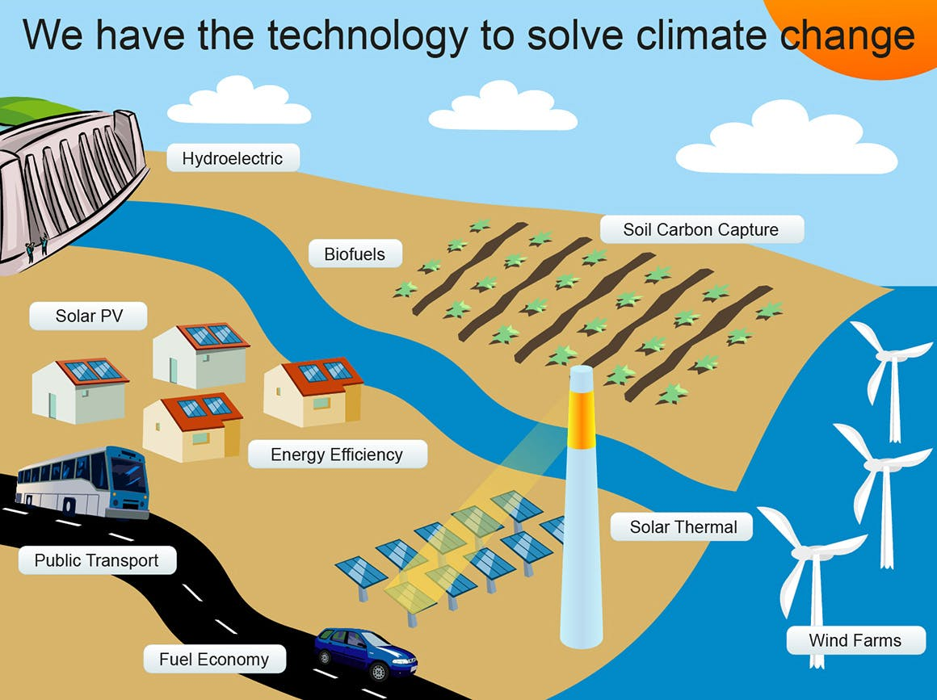
Technology as Savior
In short – we use technology to solve problems.
Even problems created by technology.

Slide 24


Slide 25
Why we need security
Adversarial threats
Malicious attackers
Spammers / Scammers
Cyber-vandals
Organized crime
Industrial espionage
Foreign intelligence services
Inside actors
Automated crime
Non-Adversarial threats
Bugs
Fat-fingering / Mistakes / Typos
Weather
Hardware failure
Accidental disclosure

